Slide 1
Chapter 2 Motion Along a Straight Line
2-0. Mathematical Concept
2.1. What is Physics?
2.2. Motion
2.3. Position and Displacement
2.4. Average Velocity and Average Speed
2.5. Instantaneous Velocity and Speed
2.6. Acceleration
2.7. Constant Acceleration: A Special Case
2.8. Another Look at Constant Acceleration
2.9. Free-Fall Acceleration
2.10. Graphical Integration in Motion Analysis

Slide 2
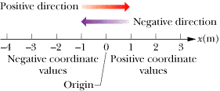
Defining a Coordinate System
One-dimensional coordinate system consists of:
a point of reference known as the origin (or zero point),
a line that passes through the chosen origin called a coordinate axis, one direction along the coordinate axis, chosen as positive and the other direction as negative, and the units we use to measure a quantity

Slide 3
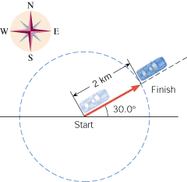
Scalars and Vectors
A scalar quantity is one that can be described with a single number (including any units) giving its magnitude.
A Vector must be described with both magnitude and direction.
A vector can be represented by an arrow:
The length of the arrow represents the magnitude (always positive) of the vector.
The direction of the arrow represents the direction of the vector.

Slide 4
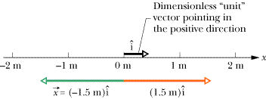
A component of a vector along an axis (one-dimension)
A UNIT VECTOR FOR A COORDINATE AXIS is a dimensionless vector that points in the direction along a coordinate axis that is chosen to be positive.
A one-dimensional vector can be constructed by:
Multiply the unit vector by the magnitude of the vector
Multiply a sign: a positive sign if the vector points to the same direction of the unit vector; a negative sign if the vector points to the opposite direction of the unit vector.
A component of a vector along an axis=sign × magnitude

Slide 5
Difference between vectors and scalars
The fundamental distinction between scalars and vectors is the characteristic of direction. Vectors have it, and scalars do not.
Negative value of a scalar means how much it below zero; negative component of a vector means the direction of the vector points to a negative direction.

Slide 6
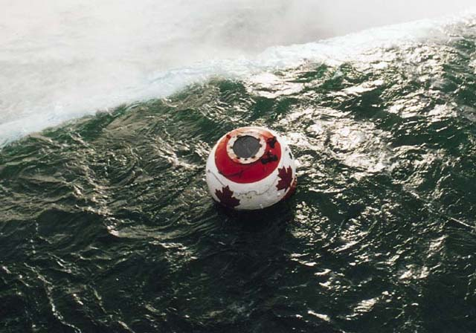
Motion
The world, and everything in it, moves.
Kinematics: describes motion.
Dynamics: deals with the causes of motion.

Slide 7

One-dimensional position vector
The magnitude of the position vector is a scalar that denotes the distance between the object and the origin.
The direction of the position vector is positive when the object is located to the positive side of axis from the origin and negative when the object is located to the negative side of axis from the origin.

Slide 8
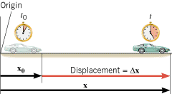
Displacement
DISPLACEMENT is defined as the change of an object's position that occurs during a period of time.
The displacement is a vector that points from an object’s initial position to its final position and has a magnitude that equals the shortest distance between the two positions.
SI Unit of Displacement: meter (m)

Slide 9
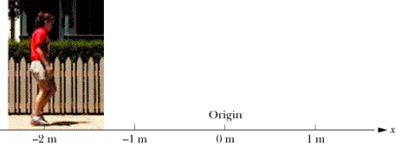
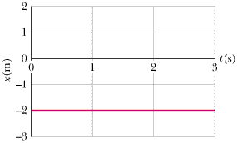
Velocity and Speed
A student standing still with the back of her belt at a horizontal distance of 2.00 m to the left of a spot of the sidewalk designated as the origin.

Slide 10
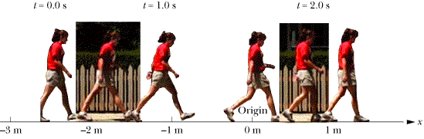
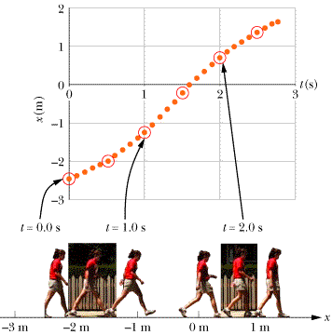
A student starting to walk slowly. The horizontal position of the back of her belt starts at a horizontal distance of 2.47 m to the left of a spot designated as the origin. She is speeding up for a few seconds and then slowing down.

Slide 11
Average Velocity
x₂ and x₁ are components of the position vectors at the final and initial times, and angle brackets denotes the average of a quantity.
SI Unit of Average Velocity: meter per second (m/s)

Slide 12
Average Speed
Average speed is defined as:

Slide 13
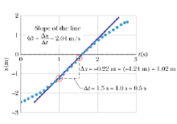
Instantaneous Velocity and Speed
The instantaneous velocity of an object can be obtained by taking the slope of a graph of the position component vs. time at the point associated with that moment in time
The instantaneous velocity can be obtained by taking a derivative with respect to time of the object's position.
Instantaneous speed, which is typically called simply speed, is just the magnitude of the instantaneous velocity vector,

Slide 14
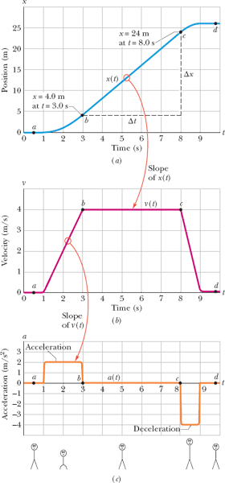
How to Describe Change of Velocity ?

Slide 15
Definition of Acceleration
SI Unit of Average Acceleration: meter per second squared (m/s²)

Slide 16
Instantaneous acceleration:

Slide 17
An object is accelerated even if all that changes is only the direction of its velocity and not its speed.
It is important to realize that speeding up is not always associated with an acceleration that is positive. Likewise, slowing down is not always associated with an acceleration that is negative. The relative directions of an object's velocity and acceleration determine whether the object will speed up or slow down.

Slide 18
example

Slide 19
Practice questions

Slide 20
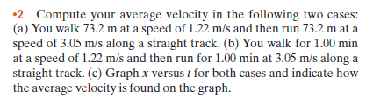

Slide 21
Sol.

Slide 23
Sol.

Slide 27


Slide 28
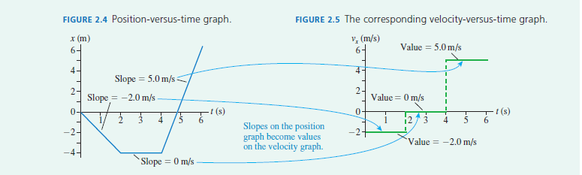
Interpreting position-versus-time graphs
●1 Steeper slopes correspond to faster speeds.
●2 Negative slopes correspond to negative velocities and, hence, to motion to the left (or down).
●3 The slope is a ratio of intervals, x/t, not a ratio of coordinates. That is, the slope is not simply x/t.

Slide 29
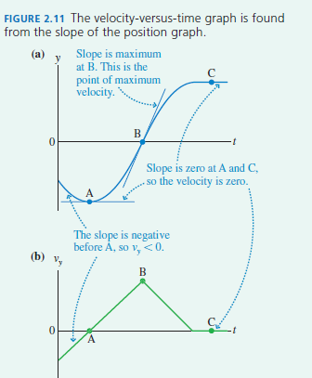

Slide 30
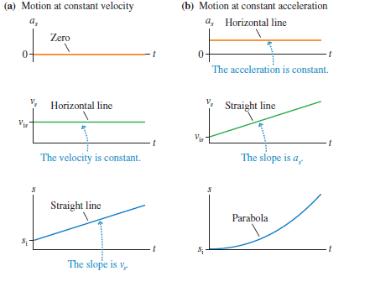

Slide 31
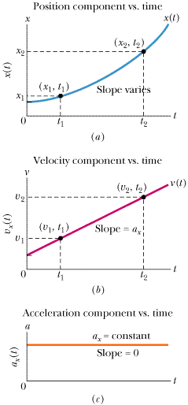
Constant Acceleration: A Special Case

Slide 32
Constant Acceleration: A Special Case

Slide 33
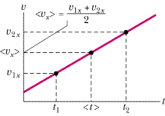
Equations of Motion with Constant Acceleration

Slide 35
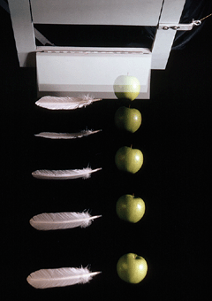
Free-Fall Acceleration

Slide 36
Free fall acceleration

Slide 37
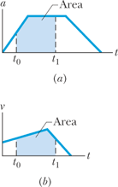


Graphical Integration in Motion Analysis
Graphical Integration in Motion Analysis

